Slide 1
Normalization

Slide 2
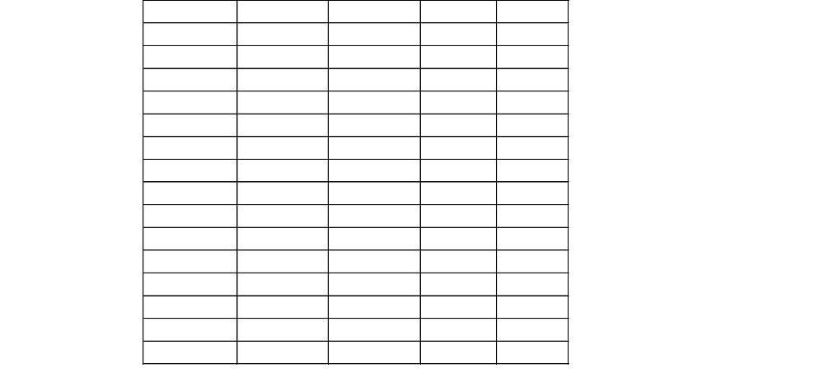
Class Exercise

Slide 3
Normalization
Normalization is the process of optimizing the tables in a database so that we create tables that are low in anomalies.
There are two anomalies that we need to be cautious of; insertion and deletion anomalies.

Slide 4
Deletion Anomaly
Look at the table to the right.
Can you spot any problems if we delete one of the rows?
If student 200 decides to cancel and we delete their corresponding row, how much does it cost to go rafting?
Stu_ID | Activity | Fees
200 | Rafting | 200
912 | Bungee | 100
492 | Bungee | 100

Slide 5
Insertion Anomaly
Continuing with this example, are there any problems with adding a new activity, say snowmobiling?
We wouldn’t be able to add snowmobiling to the table until we get a student brave enough to go.
Stu_ID | Activity | Fees
200 | Rafting | 200
912 | Bungee | 100
492 | Bungee | 100

Slide 6
Normal Forms
Normal forms can be thought of as the layers of an onion.
For example, to be in 2NF (Second Normal Form) you must be in 1NF (First Normal Form) as well.
1NF
2NF
3NF
BCNF
4NF
5NF

Slide 7
First Normal Form (1NF)
A table is in First Normal Form if every field of every record contains exactly one value.
That means arrays or fields with composite values are allowed.
Also no two rows of the table can be duplicated.
This table is in 1NF.

Slide 8
Second Normal Form (2NF)
In Second Normal Form you must remove all partial dependencies. In other words, all fields must depend entirely on the primary key. If the primary key is not a composite key and it is in First Normal Form, then it is automatically in Second Normal Form.
If the primary key is a composite key, then all of the fields in a table must depend on all of the fields in the key.
Look at the city and shipper fields. They depend upon the supplier not upon the part..

Slide 9
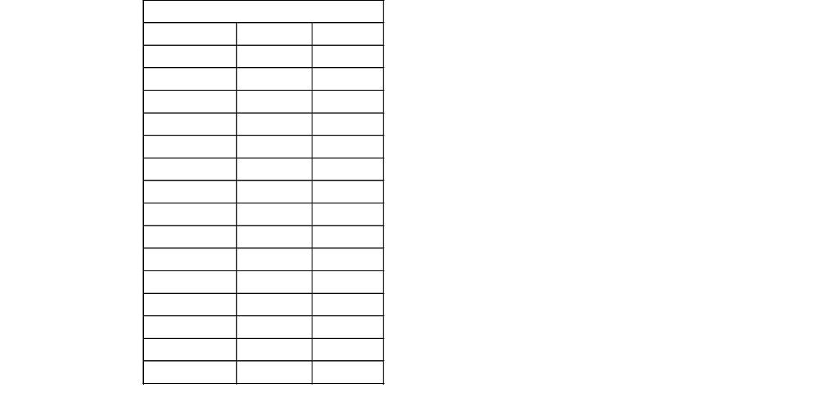
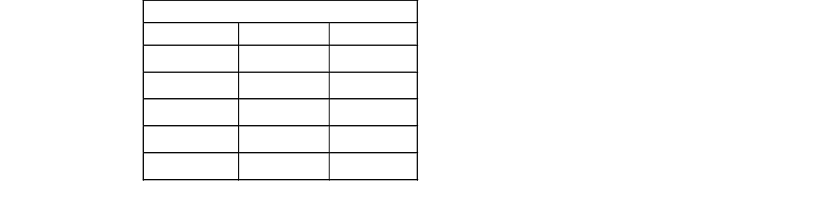
Second Normal Form (cont)
To fix the problem, we must split the previous table into multiple tables.
Now look at the tables.
In Supplier_Parts, it is in 1NF and the price depends upon both parts of the primary key, therefore, it is also in 2NF.
Supplier_City_Shipper is in 1NF and doesn’t have a composite primary key, therefore, it is also in 2NF.

Slide 10
Third Normal Form (3NF)
Are there any anomalies?
Can we enter a shipper and city without a supplier? No.
What happens if we delete a supplier? We lose the best shipper for that city.
To be in 3NF, you must remove all transitive dependencies.
A transitive dependency is when Field A depends upon Field B and Field B is not a primary key.
The shipper we use depends upon the city, making it a transitive dependency.

Slide 11
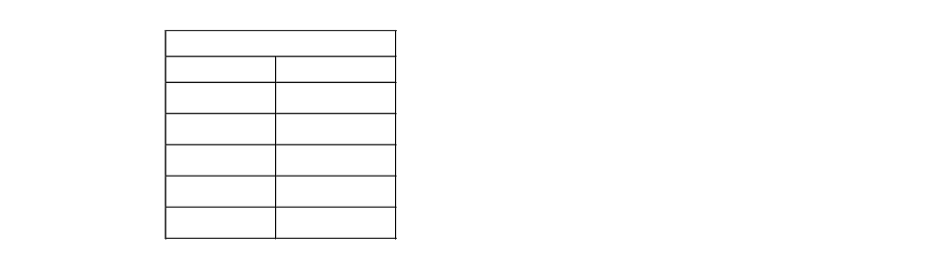
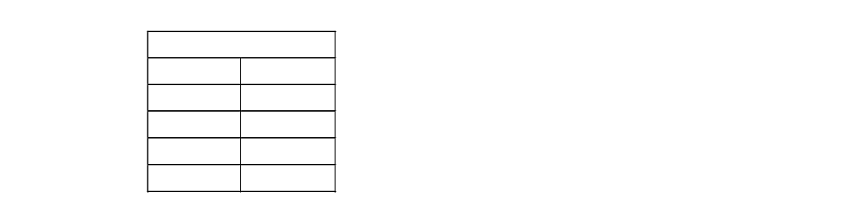
Third Normal Form (cont)
Let’s break up the Supplier_City_Shipper table.
Now look at the tables.
Are they in 3NF?
Are there any anomalies?
How can we make these tables better?

Slide 12
Exercises
Create the following databases by: 1) determining which information needs to be stored, 2) breaking the information into tables, 3) making sure all tables are in 3NF.
  Create a database that will store information needed to provide CSET labs with a problem reporting mechanism.
  Create a database that will store information on student tours here at OIT.
  Create a database that will store information on a baseball card collection.

